Slide 1

Hydrocarbons
INTRODUCTION TO ORGANIC CHEMISTRY

Slide 2
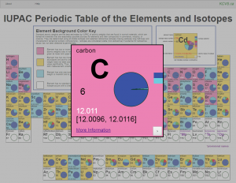
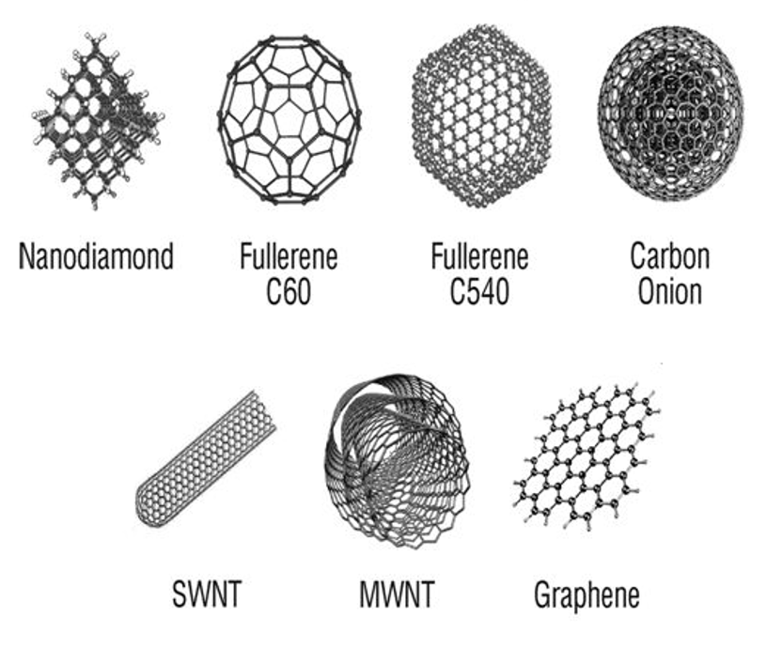
Carbon
Carbon is in group 14 of the periodic table
It has 4 valence electrons and therefore, has a covalent bonding capacity of four (can form four covalent bonds)
Carbon is in period 2 of the periodic table, making it a relatively small atom
Allotropes of pure carbon including diamond, graphite, and fullerenes (they only contain carbon atoms)
Organic compounds – hydrocarbons and organic molecules with functional groups (compound – contains two or more elements)

Slide 3
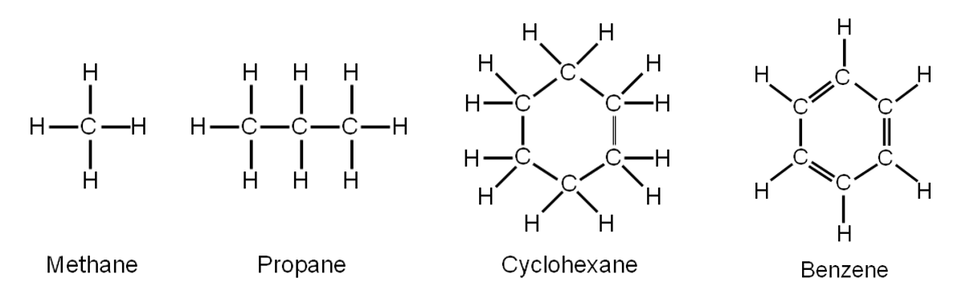
Hydrocarbons: Introduction to Organic Chemistry
Year 11: study Hydrocarbons, molecular compounds containing only hydrogen and carbon. As well as, some Halohydrocarbons (contain carbon, hydrogen and halogens)
Year 12: Organic molecules containing functional groups which contain other elements such as oxygen, nitrogen, phosphorus, halogens, sulfur etc

Slide 4
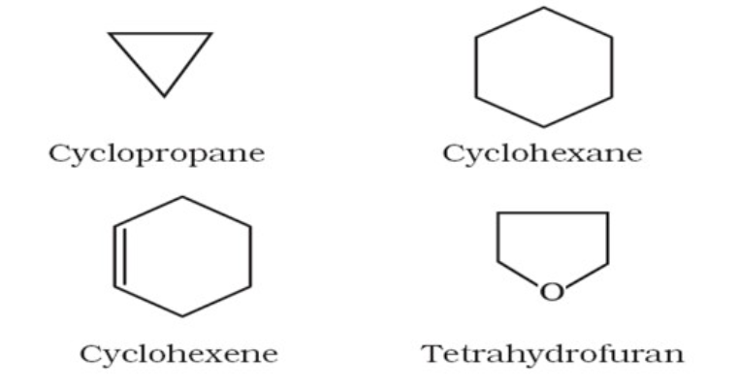

Classification of hydrocarbons
HYDROCARBONS
Acyclic or open chain
Hydrocarbons
Aliphatic hydrocarbons
Cyclic or closed chain
Hydrocarbons

Slide 5
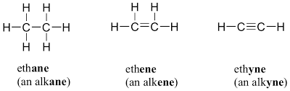
Classification of hydrocarbons
HYDROCARBONS
Acyclic or open chain
Hydrocarbons
Aliphatic hydrocarbons
Cyclic or closed chain
Hydrocarbons
Saturated
Unsaturated
Saturated = 4 bonds to 4 different atoms
Unsaturated = 4 bonds but to less than four other atoms
Alkanes
Alkenes
Alkynes

Slide 6
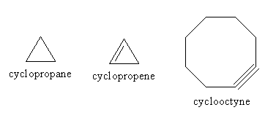
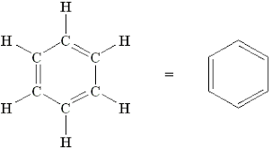
Classification of hydrocarbons
HYDROCARBONS
Cyclic or closed chain
Hydrocarbons
Alicyclic
Hydrocarbons
Aromatic
Hydrocarbons
Saturated
Unsaturated
Cycloalkanes
Cycloalkenes
Cycloalkynes

Slide 7
Representations of hydrocarbons
Different ways to represent molecules, all the methods have pros and cons and are therefore used for different reasons
Name of the molecules – we use IUPAC naming for organic molecules
Molecular formula – shows only the elements presents in the molecule
Lewis structure diagram – we show all valence electrons (bonding and non-bonding).
Condensed formula – also called the semi-structural formula, it shows how the atoms are connect but not the bonding involved.
Structural formula – shows all the atoms and bonds in a molecule
Space filling and Ball and Stick models – shows the 3D shape of a molecule

Slide 8
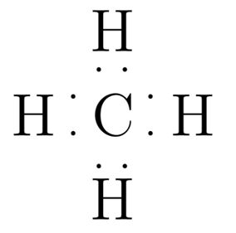
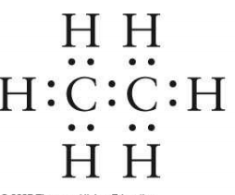
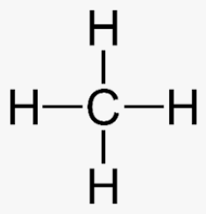
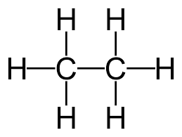
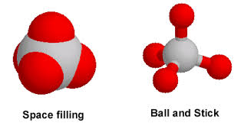
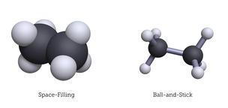
Representations of hydrocarbons
Name: | Methane | Ethane
Molecular formula | CH₄ | C₂H₆
Lewis structure diagram
Condensed formula | CH₄ | CH₃CH₃
Structural formula
Molecular shape (space filling model) and ball and stick model

Slide 9
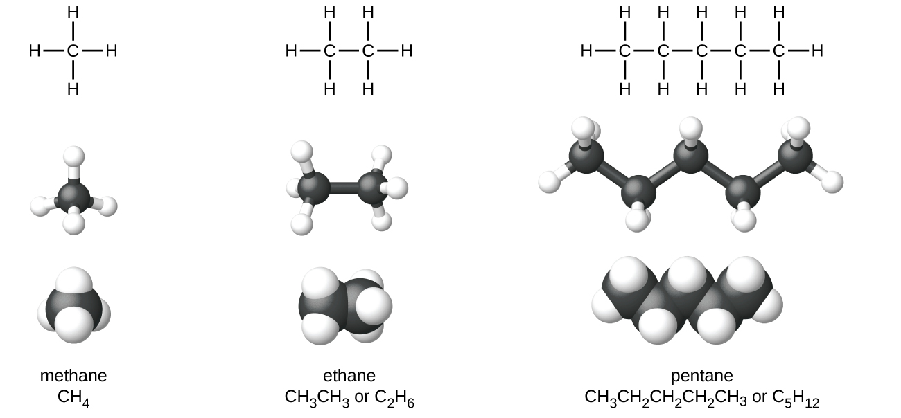
Representations of hydrocarbons

Slide 10
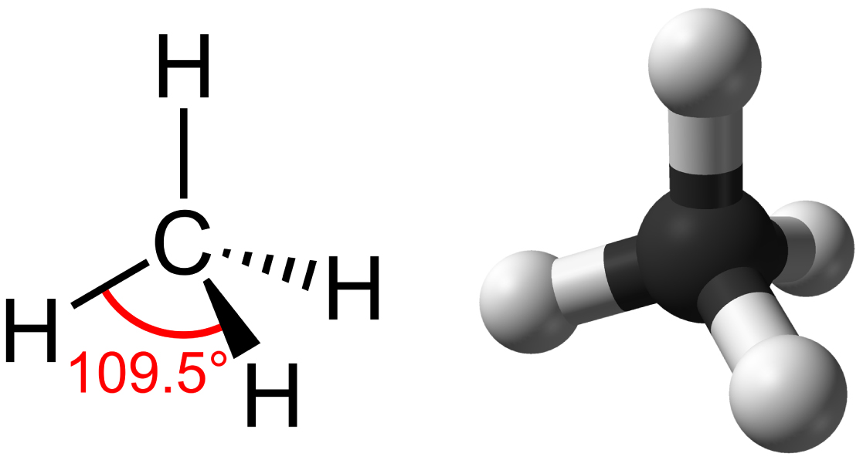
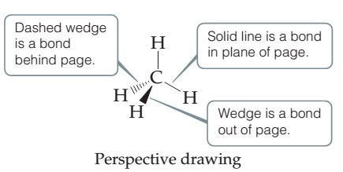
Representations of hydrocarbons
Perspective drawing:

Slide 11
Classes of hydrocarbons
We will be look at the following classes of hydrocarbons:
Alkanes and cycloalkanes
Alkenes and cycloalkenes
Alkynes and cycloalkynes
Aromatic compounds – benzene
The compounds in each group have similar:
Structures
Patterns of physical properties
Chemical properties
The same general formula

Slide 12
Structure of lessons
For each of the four groups we will cover the following:
General information including the General formula
Naming conventions (being able to draw a structure from a name and being able to write the name from the structure)
Isomers
Physical properties and trends
Chemical reactions

Slide 13
Naming of hydrocarbons
We use IUPAC naming principles
IUPAC = International Union of Pure and Applied Chemistry
“The IUPAC nomenclature system is a set of logical rules devised and used by organic chemists to circumvent problems caused by arbitrary nomenclature. Knowing these rules and given a structural formula, one should be able to write a unique name for every distinct compound. Likewise, given an IUPAC name, one should be able to write a structural formula. In general, an IUPAC name will have three essential features:
• A root or base indicating a major chain or ring of carbon atoms found in the molecular structure. • A suffix or other element(s) designating functional groups that may be present in the compound. • Names of substituent groups, other than hydrogen, that complete the molecular structure.”
Ref: https://www2.chemistry.msu.edu/faculty/reusch/VirtTxtJml/nomen1.htm

Slide 14
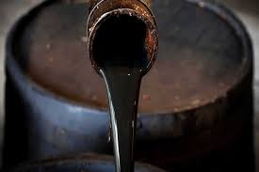
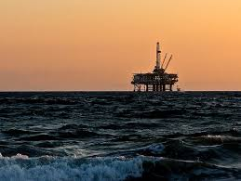
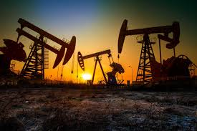
Crude Oil
Many hydrocarbons are produced from crude oil
Crude oil is formed through the effect of heat and pressure on organic material (dead vegetation and animal matter) trapped in the Earth’s crust
Crude oil takes millions of years to form

Slide 15
Crude Oil
Over millions of year organic matter trapped in the Earth’s crust is converted in to a mixture of hydrocarbons
It has a low density and accumulates in pockets called oil fields
Crude oil undergoes fractional distillation to separate out different types of hydrocarbons

Slide 16
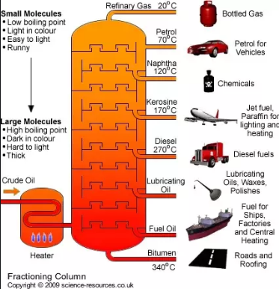
Fractional distillation
Fractional distillation, collects fractions of the crude oil based on different boiling points
Currently, roughly 90 % is used for fuel purposes

